Slide 1

California Air Quality Analysis website
KU Data Analytics BootCamp
March 16, 2021

Slide 2

Outline
INSPIRATION
AVAILABLE PRODUCTS
WHAT’S NEXT
CLOSING

Slide 3

INSPIRATION
DATA DRIVEN DECISIONS
Air Quality continues to be a growing concern for human health across California with the increase in frequency of wildfires and record temperatures. This website features three air quality products of current and historical data to help public and business corporations make data driven decisions.

Slide 4

Available products
Let’s Dive In

Slide 5
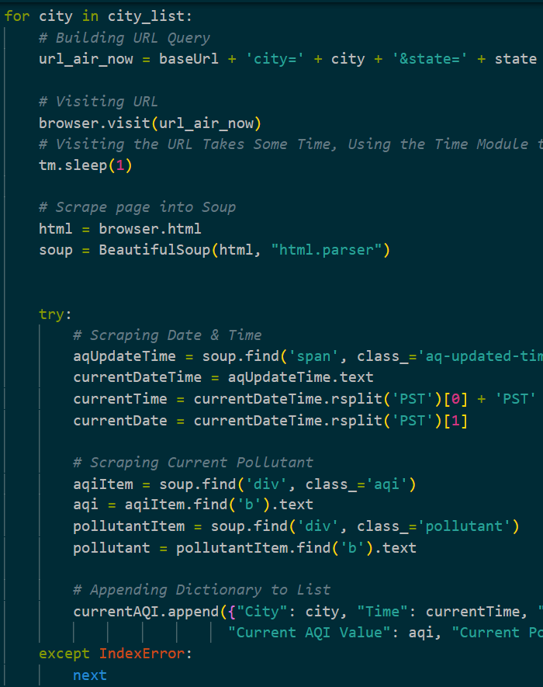
Current air quality
Glimpse into Back-End Process
Web Scraping AirNow.gov with Beautiful Soup
Maintain Best Practices to Prevent from getting Blocked!
AirNow.gov also has API Keys.
This is highly recommended!
The scrape takes 15 minutes!
The concept was to keep this code running and updating the CSV every hour.
Created a sleeper() function to achieve this idea.

Slide 6
Current Air Quality
Let’s Look into the Front-End

Slide 7
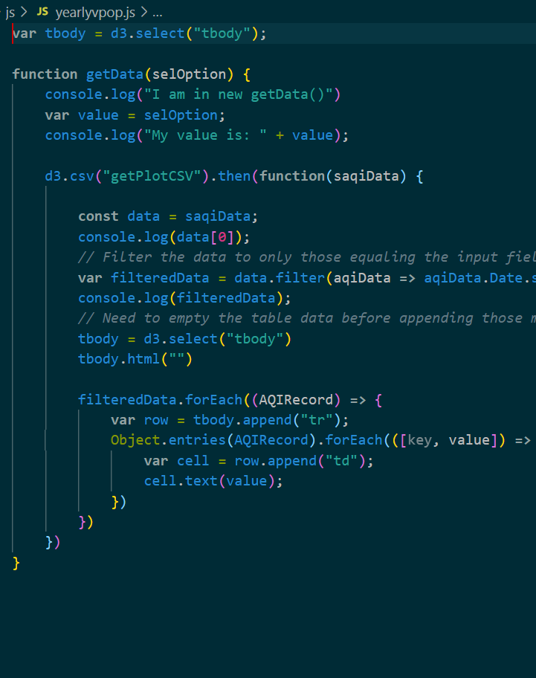
HISTORICAL DATA
Glimpse into Back-End Process
Dataset
EPA’s Air Quality Data https://aqs.epa.gov/aqsweb/airdata/download_files.html
Contain historical data regarding Air Quality and Pollutants throughout the United States.
The AQI data files are posted by year; to obtain data for 2010 through 2020, 11 files were downloaded, aggregated, and cleaned.
A Data Table was made using JS

Slide 8
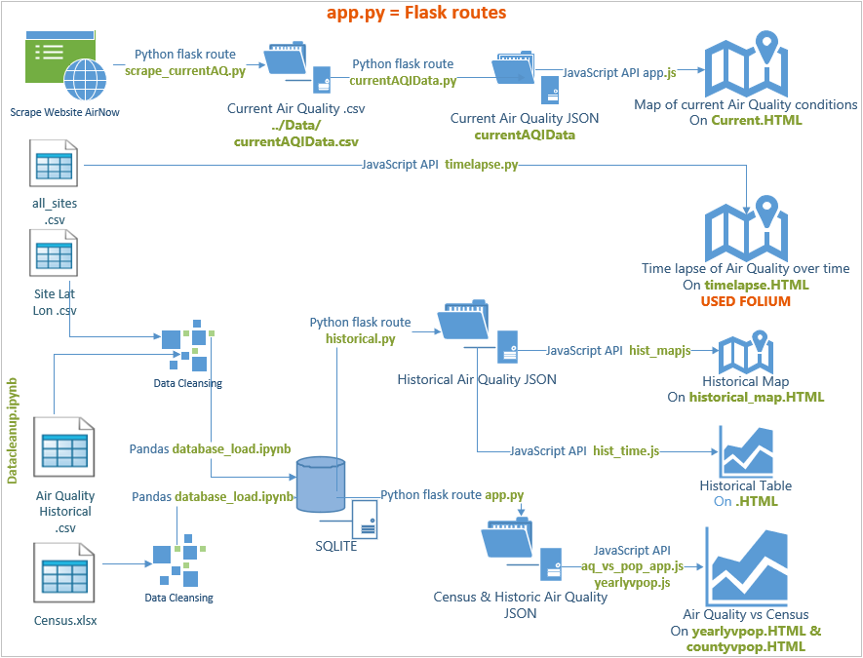
App Diagram
Build a Flask driven Website to gather Air Quality data & send to html pages using, Python, JavaScript, & HTML/CSS

Slide 9
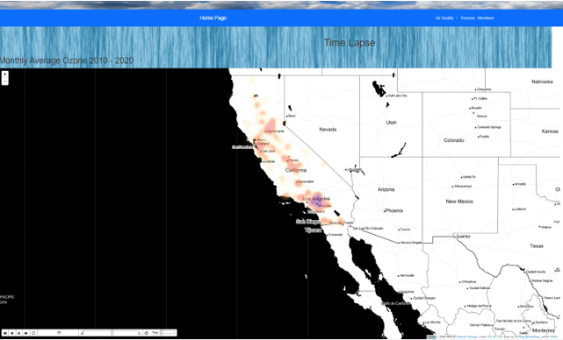
Time Lapse
Glimpse into Back-End Process
Visualizing Ozone from 2010 to 2020
Utilizing the data from the EPA website
TimelapseWithTime
A plugin from Folium, a Python library that allows data wrangling and wrapping Leaflet.js for mapping.
Data Cleaning Process
AQI Ozone indices were averaged over the course of each month and plotted based upon intensity.
Future Work
Add a layer control that can switch among pollutants
Revamping historical heat map
We wanted to provide the ability to select a date range and the air pollutant parameter (Ozone, PM2.5, PM10 etc.).
Folium library proved to be very difficult to use and displaying the resulting HTML adequately in the web page took much longer than anticipated.

Slide 10
Current Air Quality
Let’s Look into the Front-End

Slide 11
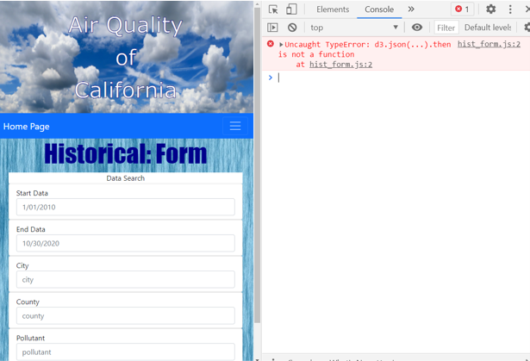
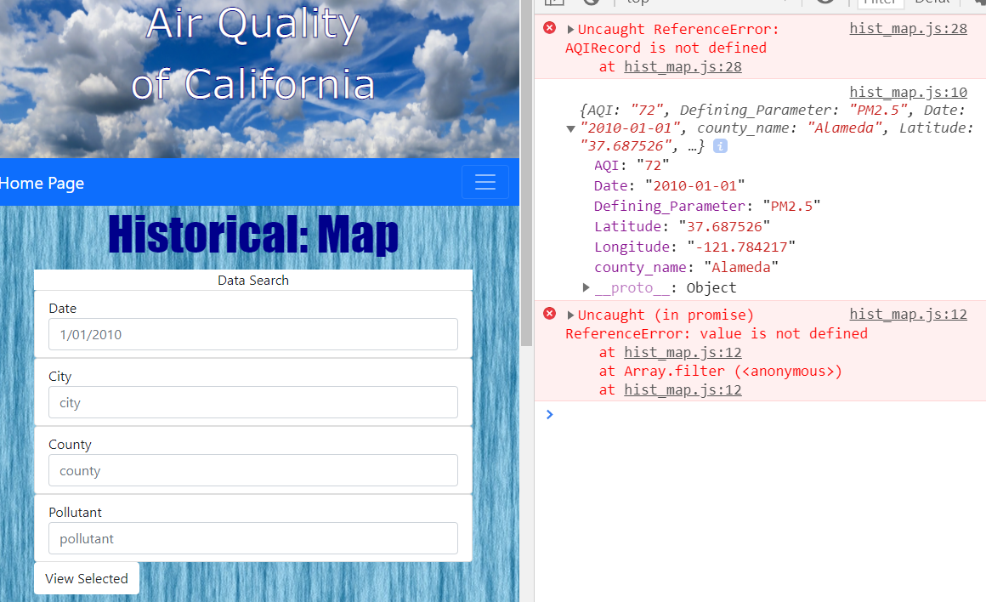
BUILDING A HISTORICAL MAP AND FORM
Ran out of time to troubleshoot issues between source data & JavaScript through Flask app
Intended to have more options to choose limits by County & Defining Parameter
AIR QUALITY VS. CENSUS POPULATION
Ran out of time to get visuals to work properly to compare Air Quality to Census Population
Unable to create scatter plot of pollutants to population of counties over 10 years.
Data was loaded in database, but unsuccessful in creating visualizations intended.

Slide 12

What’s next
LOOKING AHEAD
* Incorporate population data * Graphs to compare specific counties and cities * Filter form to allow users to choose specific data for each county, city, pollutant, and/or date * Filter map to allow users to choose specific data for each county, city, pollutant, and/or date * Update current data on timed basis or user request * Prediction of future air quality

Slide 13
THANK YOU
K. St. Germain | M. Nolker | J. Headlee | A. Perez

